Slide 1
Visualisation of Classical Graph Theory Problems
Fatma Al-Sayegh

Slide 2
Contents
Introduction
Chosen Graph Problems
Demo
Prior Work
Requirements
Design
Implementation
Evaluation
Conclusion

Slide 3
Motivation: Why Graph theory?
Graphs are found in natural world:
Social Networks
Gene Expression Networks
Ecology
Abstraction of real world phenomenon to graphs
Problems of graph theory are hence applicable to any such graph

Slide 4
Motivation: Visualisation versus Formalism
Visualisation:
Presents a concrete example
Can give easy and fast insights to the student.
Formalism (in notation of set theory)
Formalism is general, abstract and complete.
Can give easy and fast insights to the student.

Slide 5
Aim
Create computer animation and tasks
to explain graph theory problems
such as Graph Colouring, Graph Isomorphism and Max Cut.

Slide 6
Chosen Graph Problems
Graph Isomorphism.
Max K Cut
Graph Colouring
Minimum Vertex Cover
Tree Width

Slide 7
Demo

Slide 8
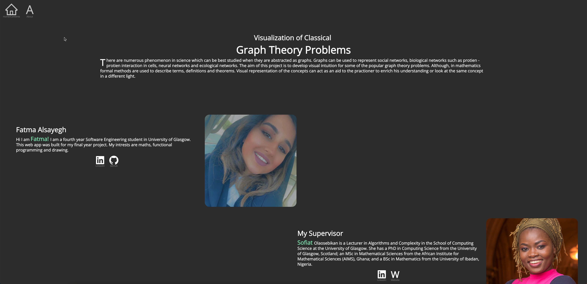

Slide 9
Prior Work
VisuAlgo (Vertex Cover) - NSU
AlgMatch - Liam’s Work
Novelty of this project:
The goal is to explain the definition of harder problems and not give solutions (algorithms)

Slide 10
Requirements
Scope:
Focus is on presenting the problems, will not include algorithmic solutions.
Core requirement for the application:
Must visualise and explain the Classical Graph Theory Problems via interactive animations and tasks.

Slide 11
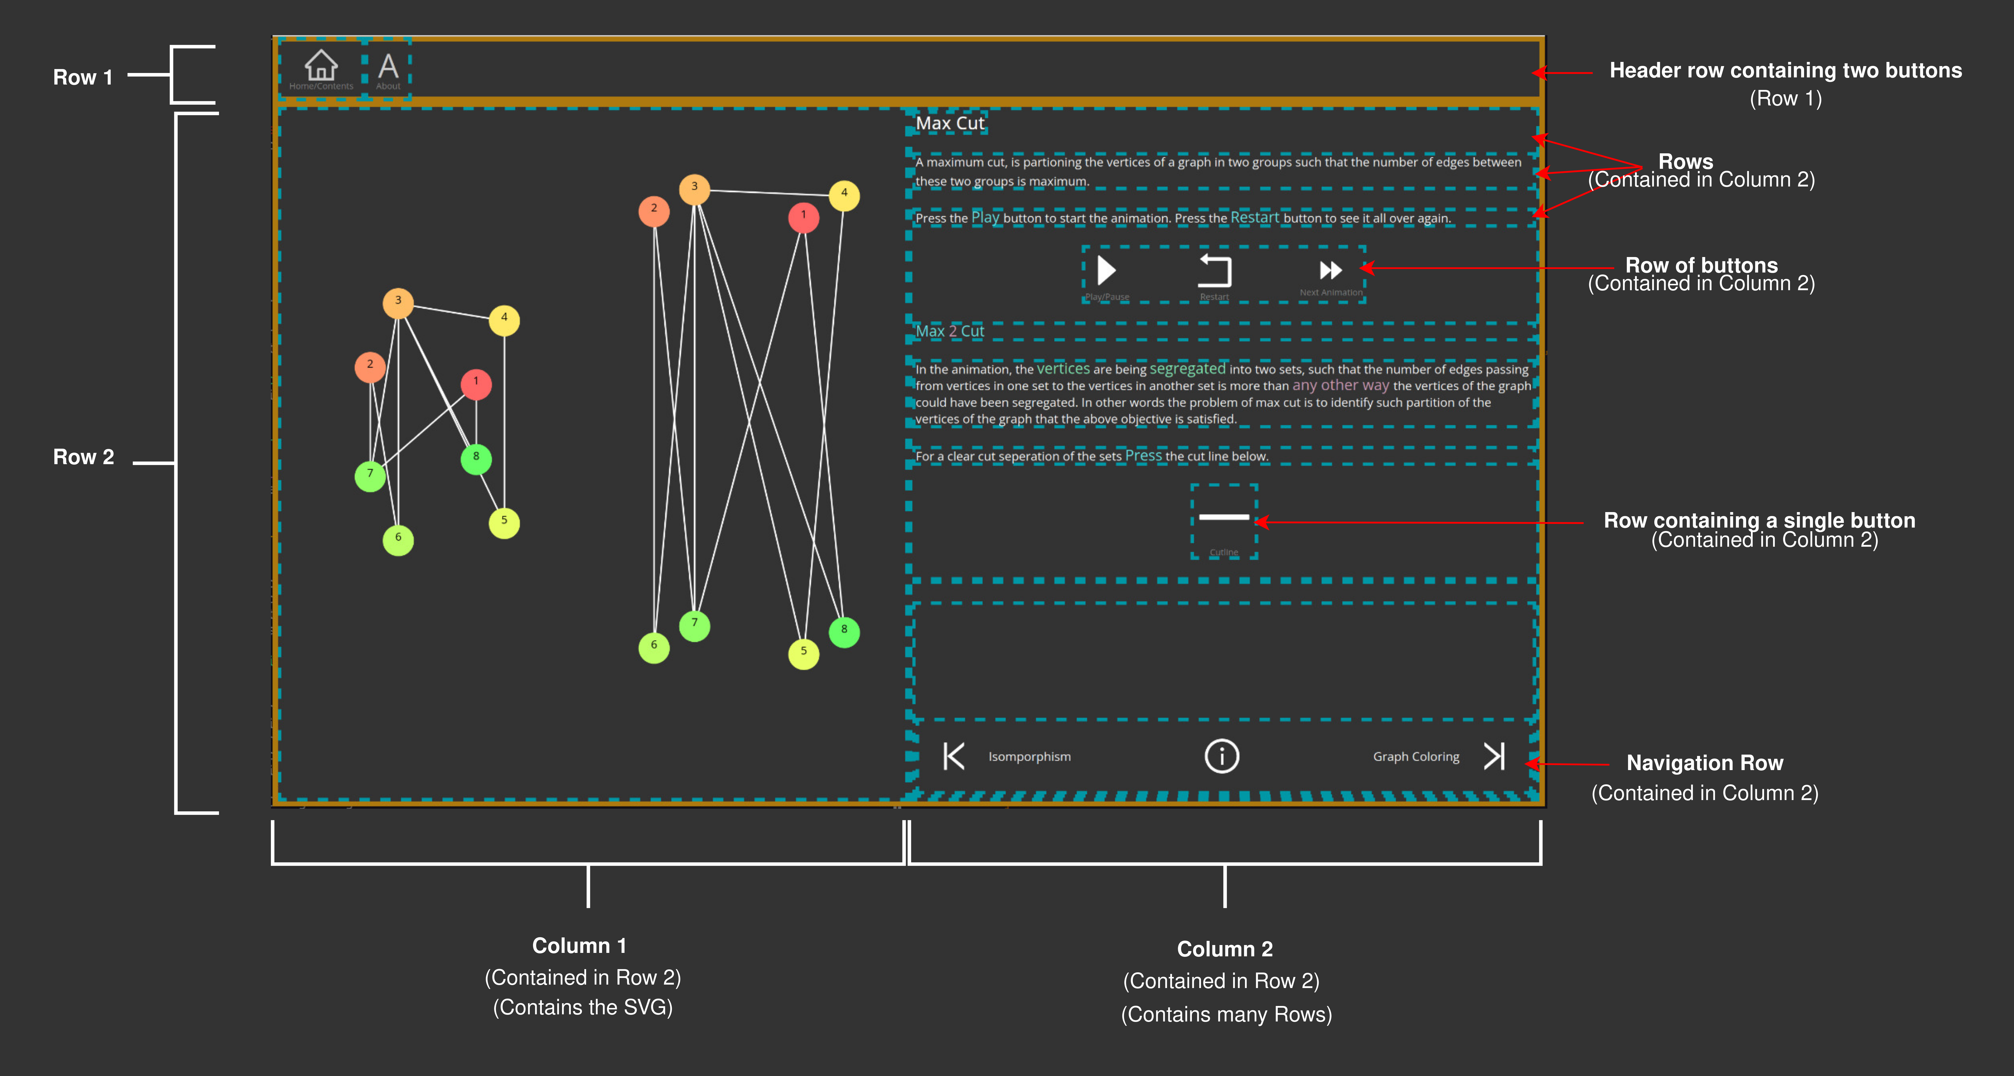
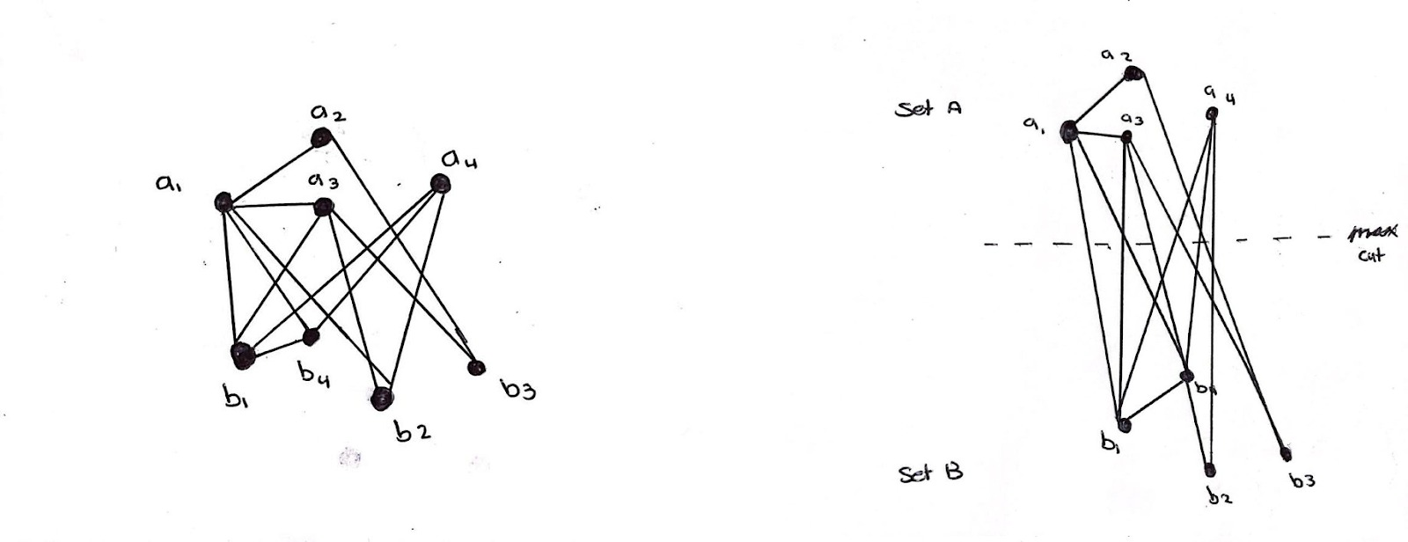
Design
Guiding Principles:
Simplicity
Intuitiveness
Prototyping:
User interface wireframe
User stories for explanation of topics

Slide 12
Implementation - Functional Programming
Functional programming for front end (Elm Language)
Functions are first class citizens
Elm complies to JavaScript
Message passing and Messages as Algebraic Data Type
Implementation of User Interactive tasks and Animation

Slide 13
Implementation - Graph Drawing

Slide 14
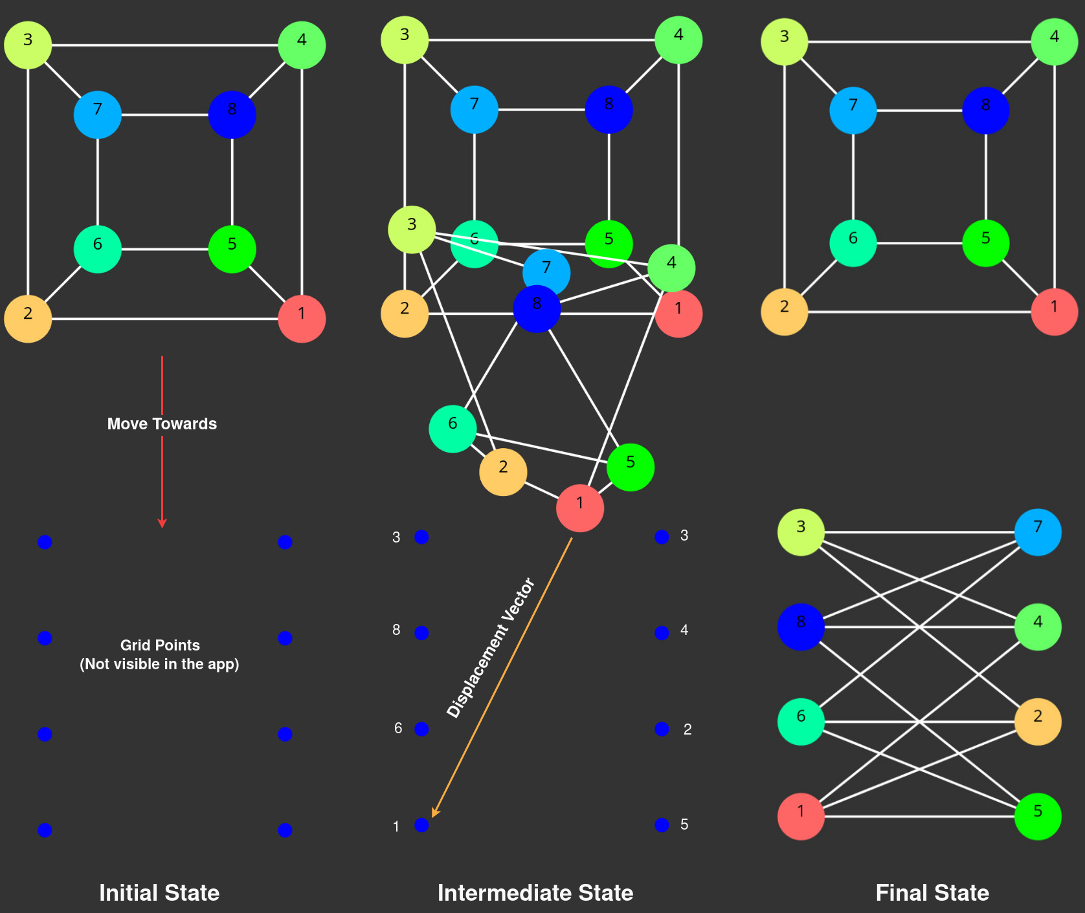
Implementation - Animation of Graph Transformation
Example Isomorphism

Slide 15
Evaluation
Project is evaluated two major themes user interaction part and learning effectiveness
Supervised
Participant were given guided tour of application over Zoom
Unsupervised
Participants accessed and tested the application independently
Both evaluations used an anonymous user experience survey

Slide 16
Conclusion - Reflection
Visualisation of a particular example leads to lack of generality of the explanation but it can enrich understanding.
A lesson should not be simpler then it ought to be. This will give rise to complexity.
Complexity should be modelled using a programming paradigm which is robust, efficient and elegant ex(FP).

Slide 17
Conclusion - Future Work
Future Work
Algorithms and solutions
I/O of user defined graphs
Beyond static 2D visualisations: 3D, VR, Zoom and Navigation
Addition of new topics

Slide 18
Thank you

